Slide 1


Group 3

Slide 2
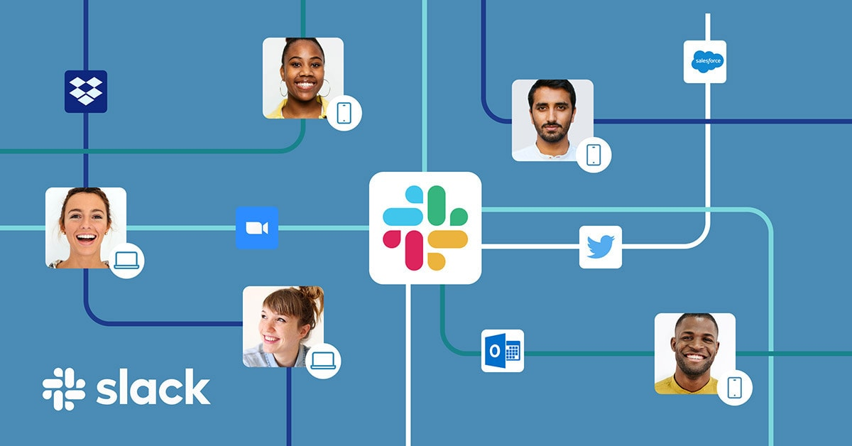
What is Slack?
Online messaging platform that enables users to collaborate efficiently.

Slide 3
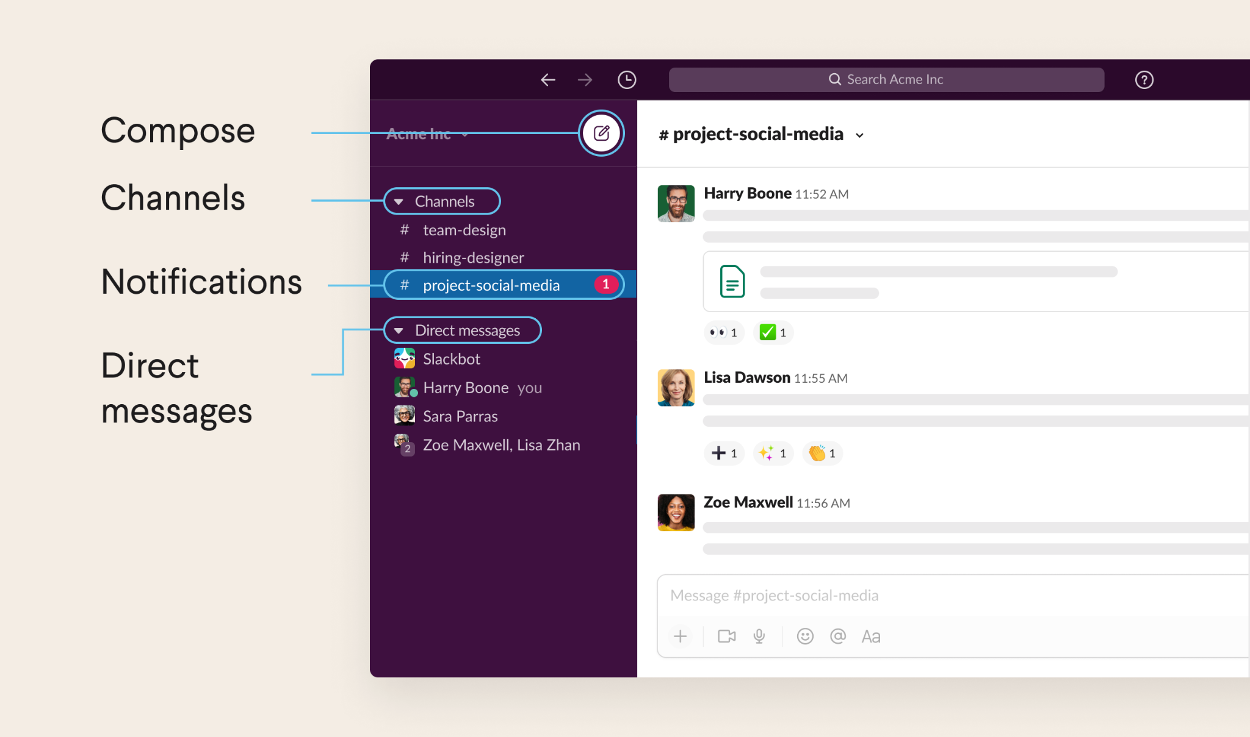
Slack features
Channels
Threads
DM
Bots
File Sharing
Video Meeting

Slide 4

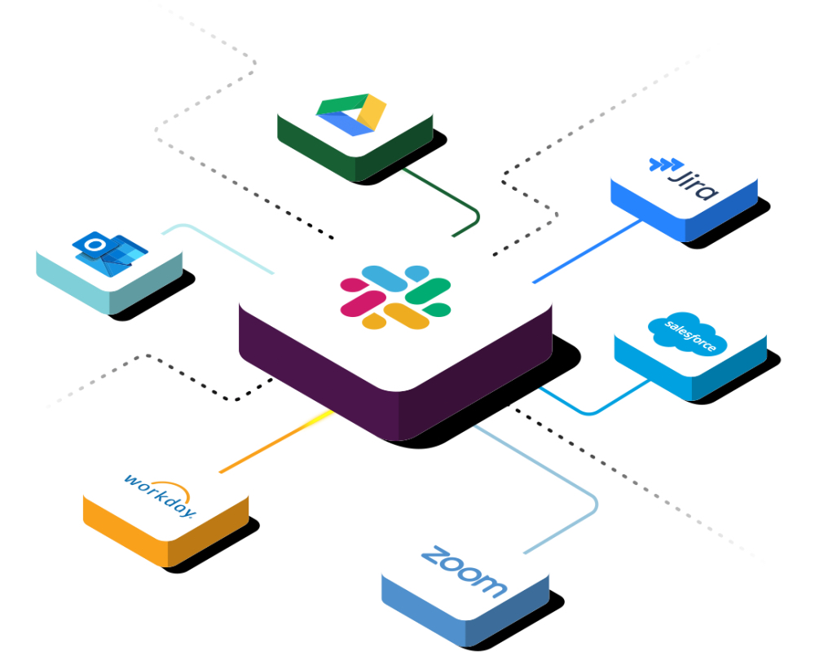
Advantages of Slack as DevOps Tools
Transparency
Flexibility
Collaboration
Integration
Automation

Slide 5
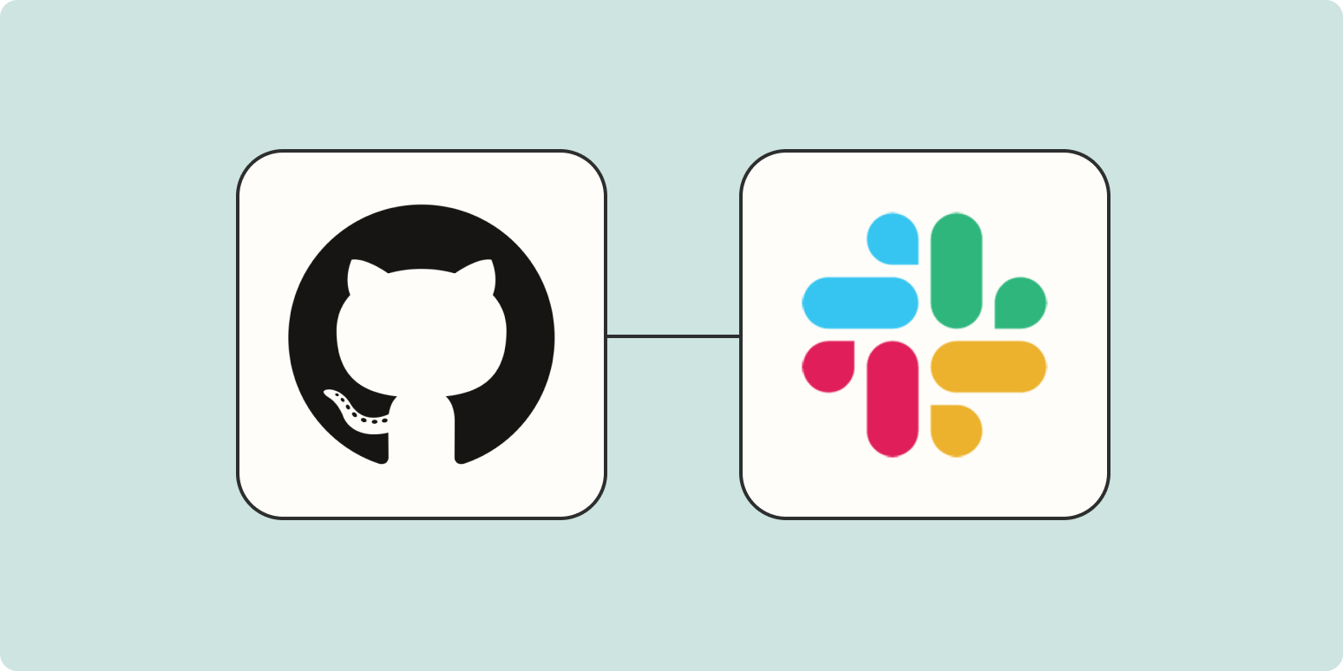
Video: How to use Slack
Download Slack
Setting up new workspace
Channels
Text formatting
Threads
Direct Messages
Huddles
Search

Slide 6


Slide 7
Video: How to Integrate GitHub with Slack
Add GitHub to our Slack Workspace
Connect our GitHub Account to Slack
Integrate Slack into our Organization
Subscribe to a Repository

Slide 8
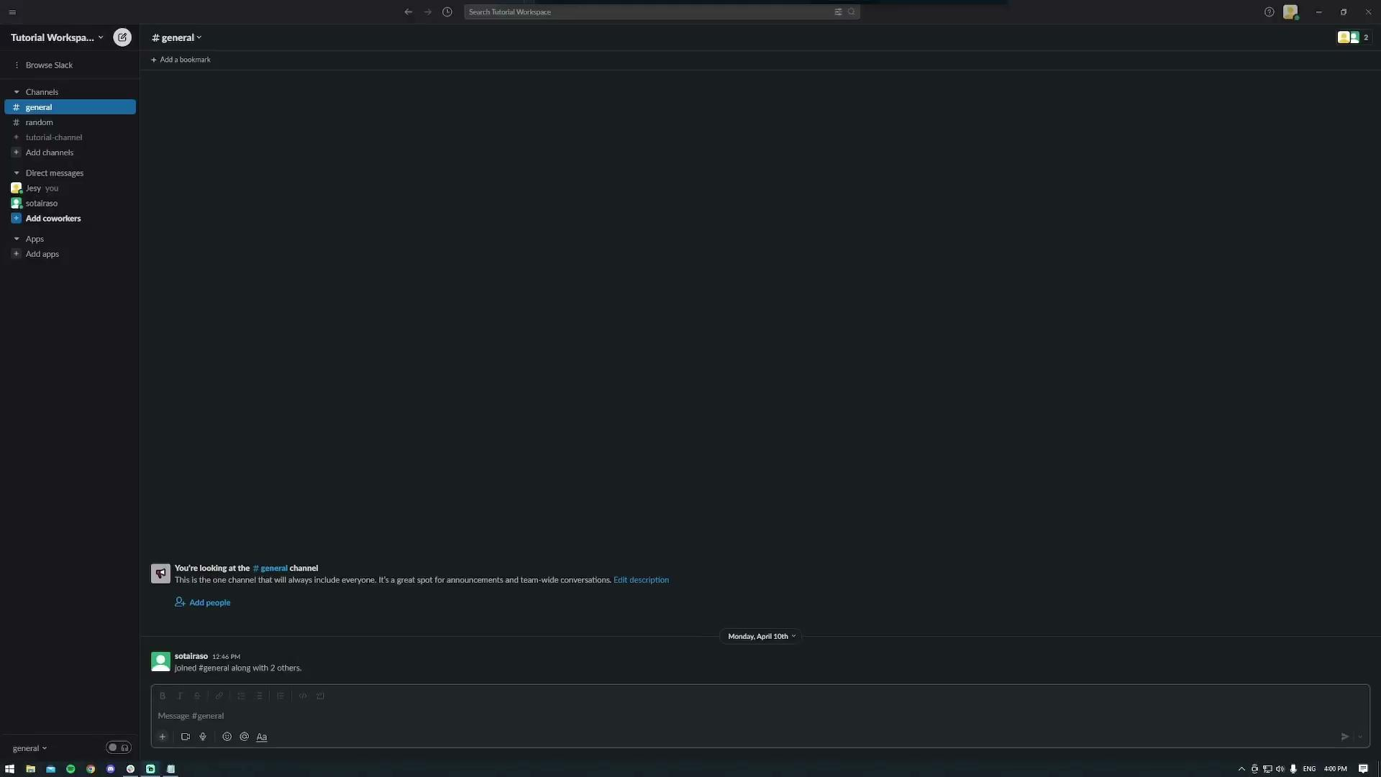

Slide 9
Video: Notifications and Scheduled Reminders
Subscribing/Unsubscribing from Certain Notifications
Filtering Notifications
Setting up Scheduled Reminders

Slide 10
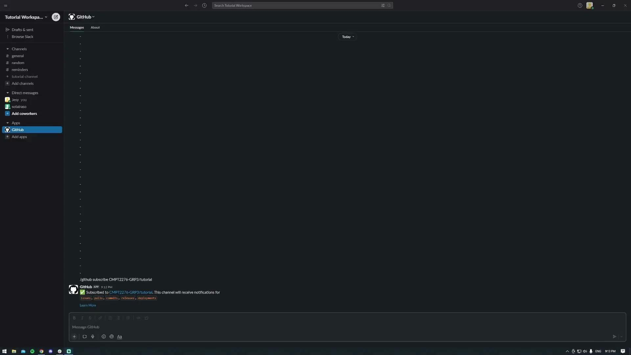

Slide 11
Video: Link Preview and Operations on issues
What is Link Preview
Opening issues
Editing issues
Closing Issues

Slide 13
https://github.com/CMPT2276-GRP3/tutorial

